Slide 1
Mind Mapping
A strategic visual to organize information

Slide 2
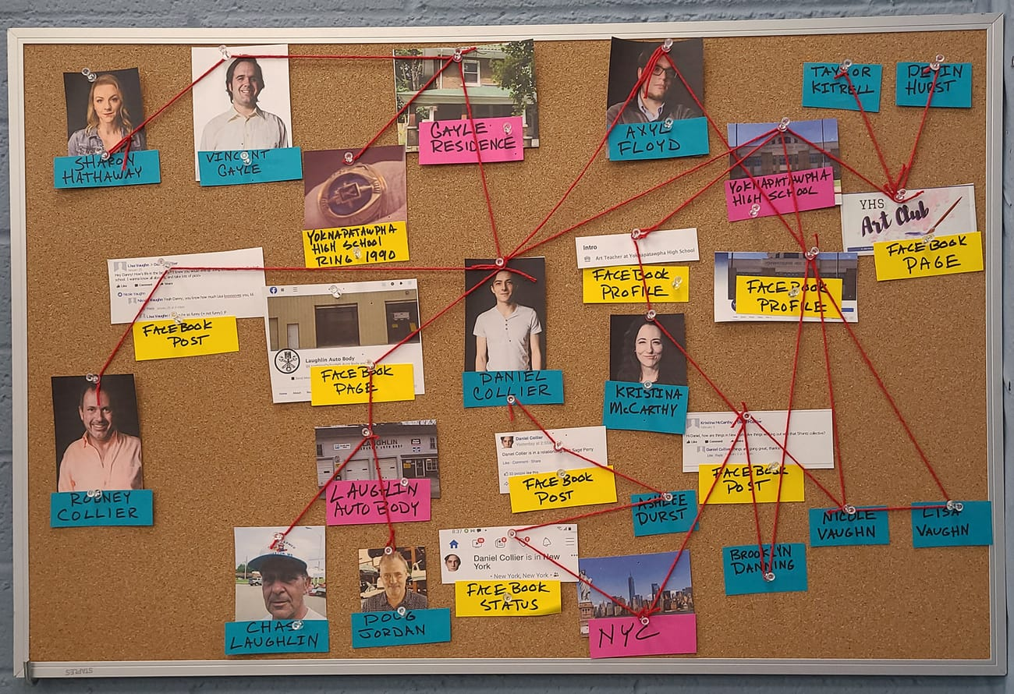
Are you familiar with a detective board?
Why don’t detectives simply write down all the cases or all aspects of one single case on a notepad?

Slide 3
Human mind is mysterious, but not omnipresent!
Mind can process either divergent thinking or convergent thinking at one time.
A divergent pattern of thought includes all possible aspects of a specific topic.
A convergent pattern of thought is focused on one single aspect in greater detail or finding a framework to consider all the aspects together

Slide 4
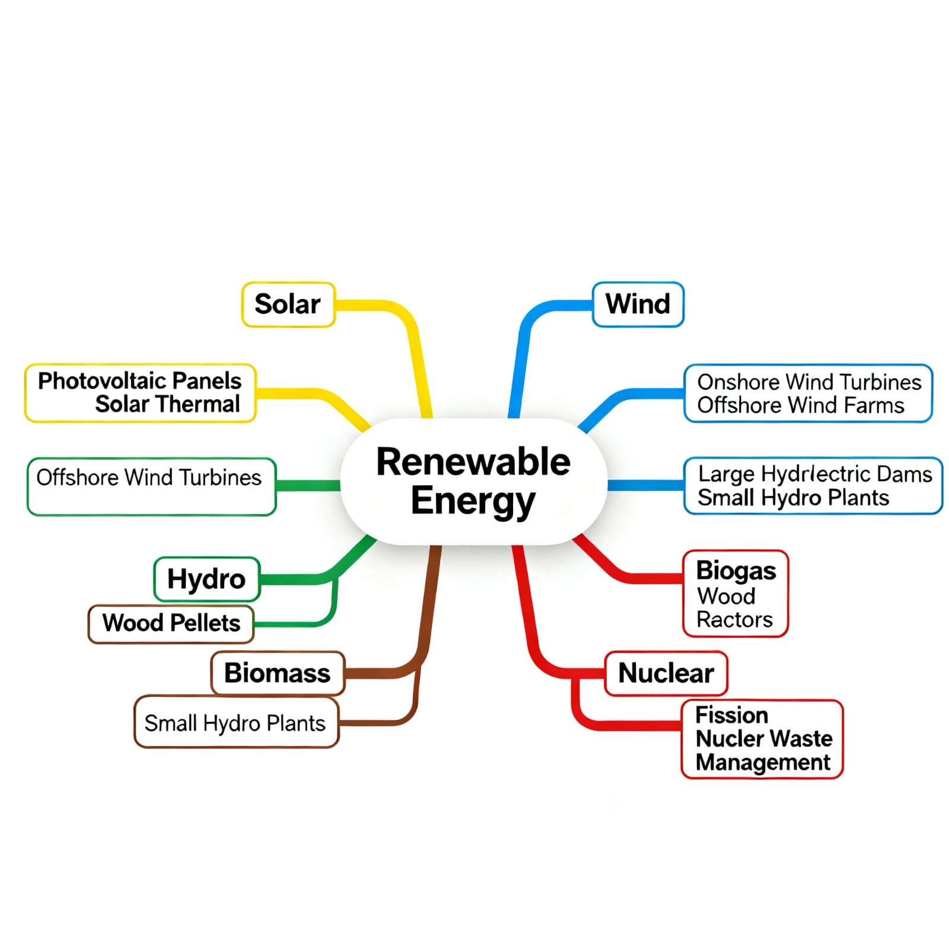
Mind map: both divergent and convergent at the same time!
Has a central concept (parent node) and uses branches (linking lines), and sub-concepts (child nodes)— divergent
Embeddes the branches within a structure, promotes the flow of ideas and their associations— convergent

Slide 5
Criteria for a Good Mind Map
A context for the mind map should be defined, commonly with a stated explicit "focus question".
Concept labels in maps should be only one or a few words labeling a specific concept.
Linking lines should be labeled with one or few words, and not contain concept labels important to the map’s conceptual content. They specify the proposition or principle formed by the concepts and linking words.
Mind maps should have hierarchical organization, with the most general, most inclusive concepts at the top, and progressive more specific, less inclusive concepts at lower levels.

Slide 6
Contd.
In general, no more than three or four sub-concepts should be linked below any given concept.
Crosslinks should specify significant interrelationships between two concepts in different sub-domains of knowledge shown in the map. These are best added when the map is nearing completion.
Concept labels should not appear more than once in a given map.

Slide 7
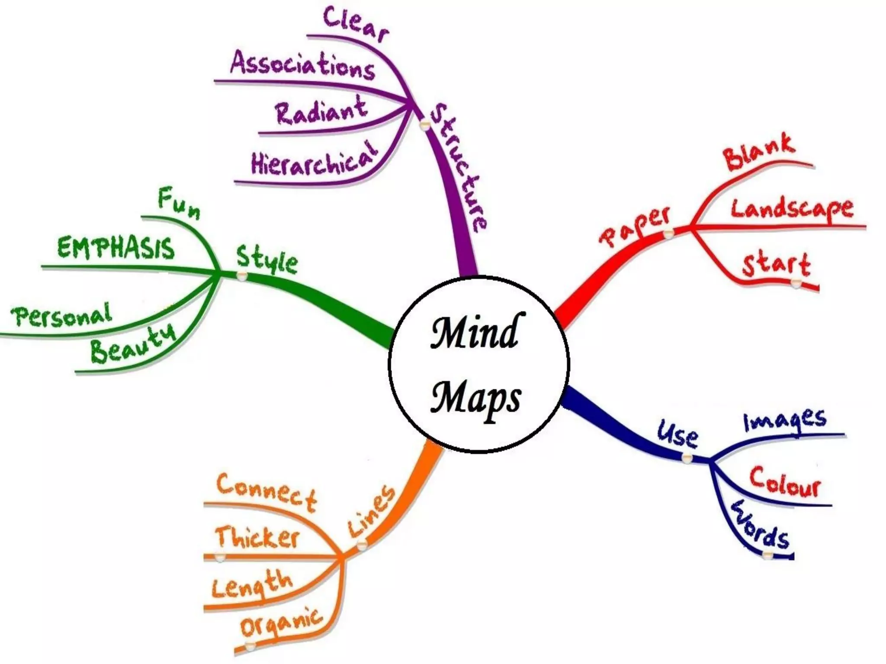
Mind map on “the features of a mind map”

Slide 8
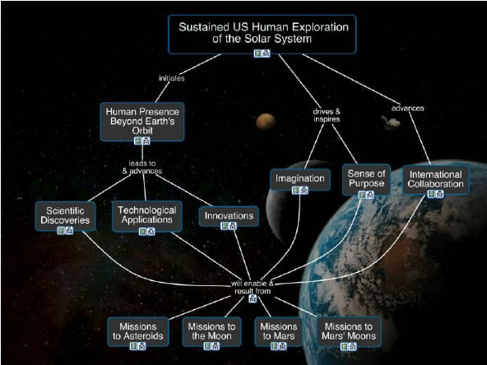
Mind map on the rationale for Human Space Exploration, answering the focus question “Why does the US have a human space exploration program?”

Slide 9
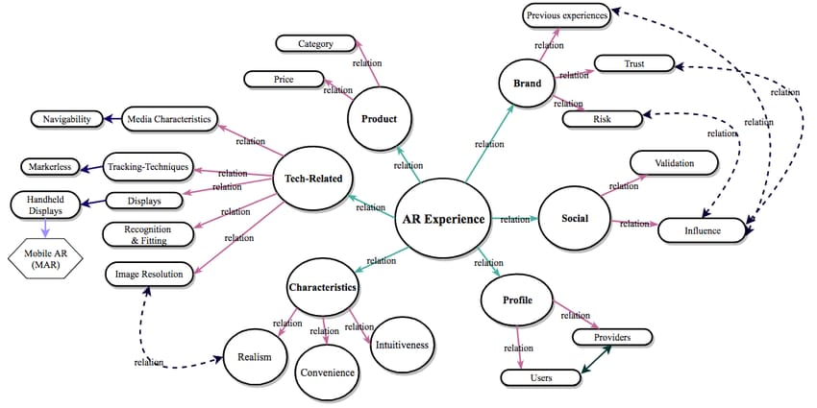
Mind map of the elements valued in an AR (Augmented Reality) Experience

Slide 10
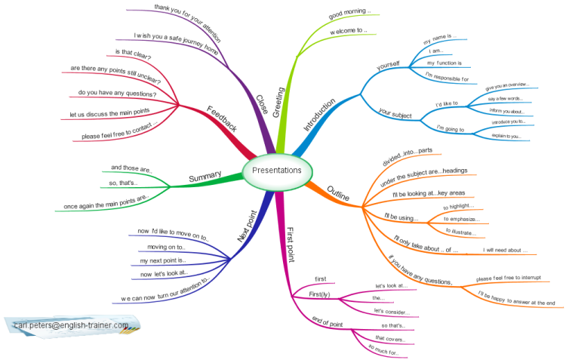
Mind map on how to frame a presentation

Slide 11
Read the paragraph and make a mind map based on it.
Effective communication involves both verbal and non-verbal elements that work together to convey meaning clearly and accurately. Verbal communication includes the choice of words, tone, clarity of speech, and organization of ideas to express thoughts precisely. It requires active listening, an appropriate vocabulary, and courteous responses to ensure understanding. Non-verbal communication, on the other hand, consists of gestures, facial expressions, posture, eye contact, and body language, all of which can strengthen or contradict spoken words. Good communicators maintain positive body language, control their tone, and match their expressions with the message they intend to share. Together, these aspects help build trust, avoid misunderstandings, and create meaningful human interaction.

Slide 12
Here are the nodes you can use to create the mind map.
Main Node: Effective Communication
Sub-Nodes:
Verbal Communication: Choice of Words, Tone, Clarity of Speech, Organisation of Ideas, Active Listening, Vocabulary, Courteous Responses
Non-Verbal Communication: Gestures, Facial Expressions, Posture, Eye Contact, Body Language, Tone Control, Expressions matching messages
Benefits: Builds Trust, Avoids Misunderstandings, Creates Meaningful Interaction
Linking Words: supports, conveys, strengthens, contradicts, complements, ensures

Slide 13
Below are a few topics that you can use to practice creating mind maps.
Causes and Effects of Pollution
Qualities of a Good Leader
Importance of Time Management
Career Planning in the 21st Century
Navigating stress as an engineering student
The role of teamwork in sports
Space travels: boons and banes in humanity
Urban life in the corporate era

Slide 14
References:
Cañas, A. J., Novak, J. D., & Reiska, P. (2015). How good is my concept map? Am I a good Cmapper? Knowledge Management & E-Learning an International Journal, 6– 19. https://doi.org/10.34105/j.kmel.2015.07.002
Rustler, F. (2012). Mind Mapping For Dummies. Wiley.

